Slide 1






#HACKDISASTER
EMPOWERING RECONSTRUCTION WITH AI-BASED DAMAGE ANALYSIS
TEAM-3
SAFESPACE VISION
1

Slide 2

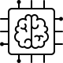

TEAM DETAILS
Andriy Lysanets
Bachelor of Computer Science, 3rd year, KNU
Trained the segmentation model and annotated datasets.
Krishna Saketh Kamadana
Masters in Computer Science,
2nd year, FSU
Trained the damage detection model and analyzed datasets.
Agnes Aliviza
Masters in System Engineering,
1st year, FSU - Panama
Gathered system requirements and cost estimation factors.
Andrii Shpilkin
Masters in Cybersecurity,
1st year, KNU
Created the ChatGPT prompts.
2

Slide 3
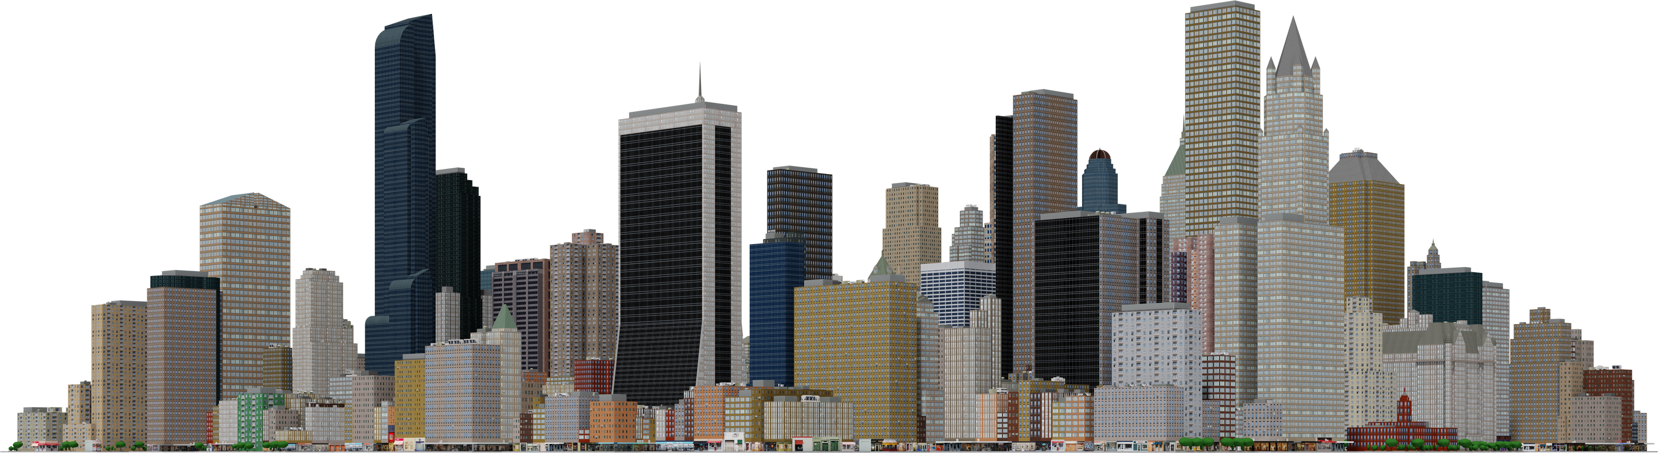
Problem Statement for Model-1
“Post-war situations often leave critical infrastructure damaged, with buildings and public properties requiring immediate repair. Traditional methods of assessing damage are slow and inefficient, often causing delays in restoration and safety hazards for citizens.”
Specific Needs:
Accurate damage assessment of buildings from multiple angles.
Quick evaluation and estimation of repair costs and resources needed.
Efficient communication of damage reports and cost estimates to emergency teams.
Real-time data processing to expedite decision-making and improve response times.
3

Slide 4

4

Slide 5


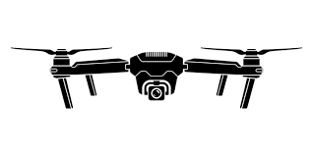


SaaS - running model
Drone sends data to cloud
reports generated
Reconstruction team action on buildings
Cloud Database
Hardware: Drones: Equipped with high-resolution cameras, GPS/IMU System,Cloud Storage
Software: Image Processing Model (API), Cloud API Integration, Budget Estimation Program
Model-1 provides fast, accurate damage detection for individual buildings using object detection. It enables quick assessment of damage and cost estimation for urgent repairs. This helps stakeholders prioritize and expedite recovery efforts for critical infrastructure
5

Slide 6
Problem Statement for Model-2
“In large-scale disasters, neighborhoods or cities often face widespread damage. Traditional assessments are slow and inefficient, highlighting the need for an automated solution that quickly analyzes damage across multiple buildings, estimates repair costs, and prioritizes recovery based on severity.“
Specific Needs:
Automated damage segmentation for buildings from multiple sources.
Accurate categorization of damage types (e.g., windows, roofs, walls).
Real-time damage assessment to speed up decision-making.
Cost estimation for repairs based on damage severity and type.
Prioritization of repairs to optimize resource allocation and recovery efforts.
6

Slide 7



SaaS - running model
Drone sends data to cloud
results on dashboard
chatgpt
phone sends data to cloud
Hardware: Drones: Equipped with high-resolution cameras, GPS/IMU System,Cloud Storage
Software: Image Processing Model (API), chatgpt API, Cloud API Integration
Model-2 segments and classifies damage within a single image. It provides detailed damage analysis and cost estimation for building using chatGPT. This accelerates recovery by helping stakeholders efficiently allocate resources and prioritize repairs across affected areas.
7

Slide 8
8

Slide 9

THANK YOU
9

